Slide 1
Programming pradgism - Functional programming -
Curry

Slide 2
Intro
Remember it? (C++)
void swapValue(int &value1, int &value2)
{
...
}
int main()
{
void(*pSwap) (int &, int &) = swapValue;
...
}

Slide 3
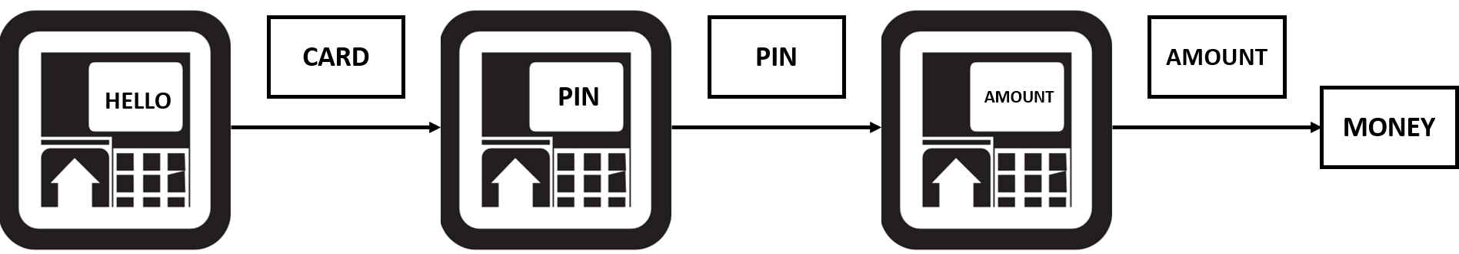

1. Curry function
We visualize withdraw money’s procedure as:
$$f:\left(Card×PIN×Amount\right)→Money$$
After we put ATM card:
$$f_{1}:\left(PIN×Amount\right)→Money$$

Slide 4
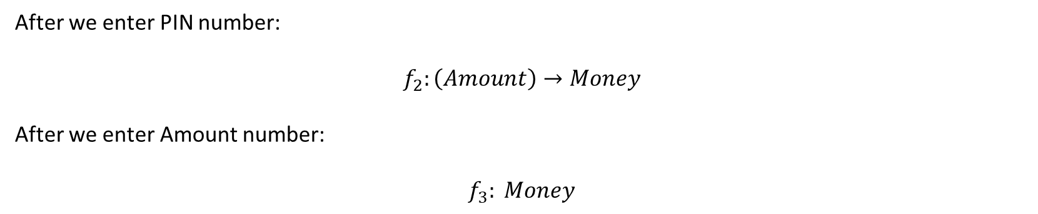
1. Curry function
After we enter PIN number:
$$f_{2}:\left(Amount\right)→Money$$
After we enter Amount number:
$$f_{3}: Money$$

Slide 5
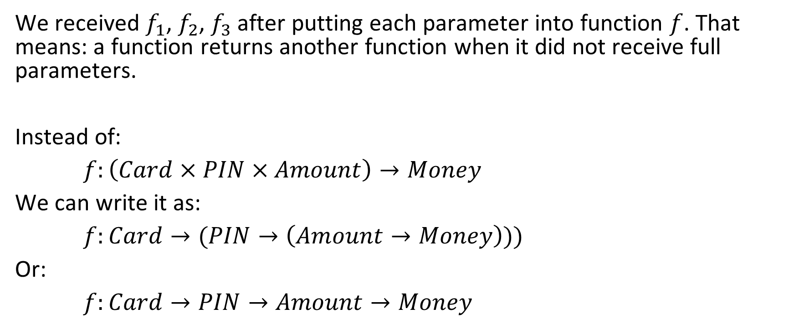
1. Curry function
We received $f_{1}$, $f_{2}$, $f_{3}$after putting each parameter into function $f$. That means: a function returns another function when it did not receive full parameters.
Instead of:
$f:\left(Card×PIN×Amount\right)→Money$
We can write it as:
$f:Card→(PIN→\left(Amount→Money\right)))$
Or:
$f:Card→PIN→Amount→Money$

Slide 6
2. Example: max function
max :: (Ord a) => a -> a -> a
max :: x y
| x > y = x
| otherwise = y
What type of (max 4)?

Slide 7
2. Excercise
We have:
multi :: (Num a) => a -> a -> a
multi x y = x * y
How to make function multi100 from multi ?

Slide 8
3. Higher order function
Higher order function is the function take another function as parameter.
Example:
applyTwice :: (a -> a) -> a -> a
applyTwice f x = f (f x)

Slide 9
3. Higher order function
Remember that now a function can take another function as a parameter and also return a function as result.

Slide 10
3. Higher order function: zipWith
zipWith is a function that combines two list by function f :: a -> b -> c
zipWith' :: (a -> b -> c) -> [a] -> [b] -> [c]
zipWith' _ [] _ = []
zipWith' _ _ [] = []
zipWith' f (x:xs) (y:ys) = f x y : zipWith' f xs ys

Slide 11
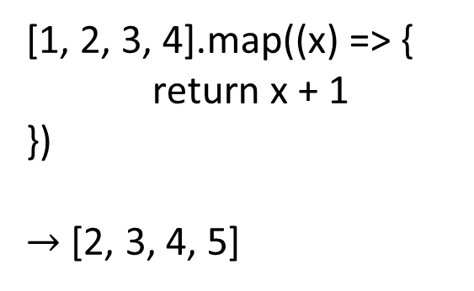
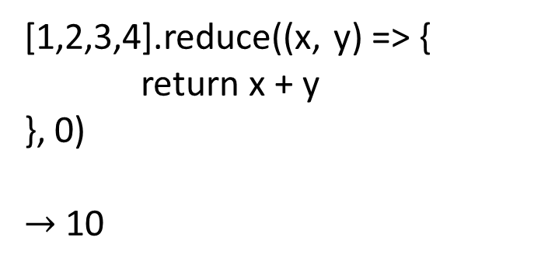
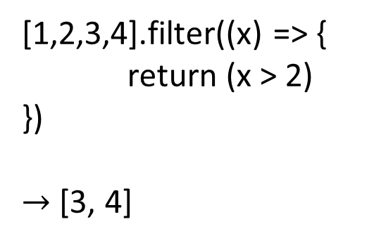
3. Higher order function: map, filter & reduce
Take a look on Javascipt
[1, 2, 3, 4].map((x) => {
return x + 1
})
$→$ [2, 3, 4, 5]
[1,2,3,4].filter((x) => {
return (x > 2)
})
$→$ [3, 4]
[1,2,3,4].reduce((x, y) => {
return x + y
}, 0)
$→$ 10
map
filter
reduce

Slide 12
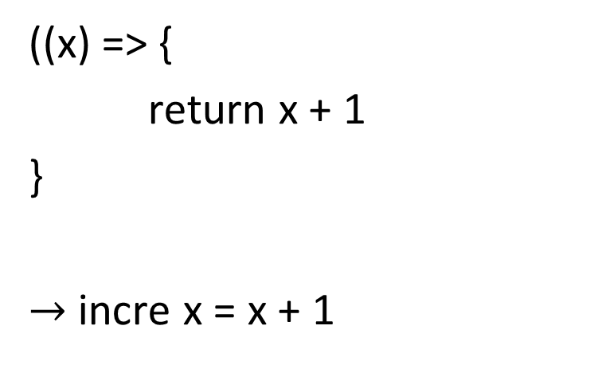
3. Higher order function: map, filter & reduce
((x) => {
return x + 1
}
$→$ incre x = x + 1
Callback
is just function without name, or anonymous function
Named function (incre)

Slide 13
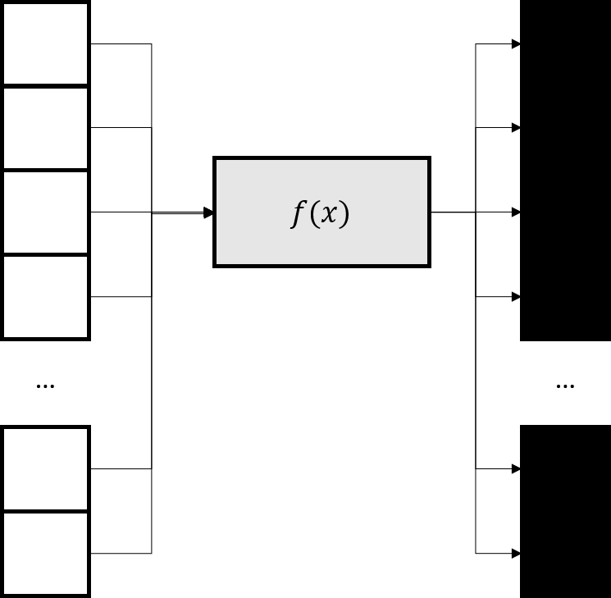
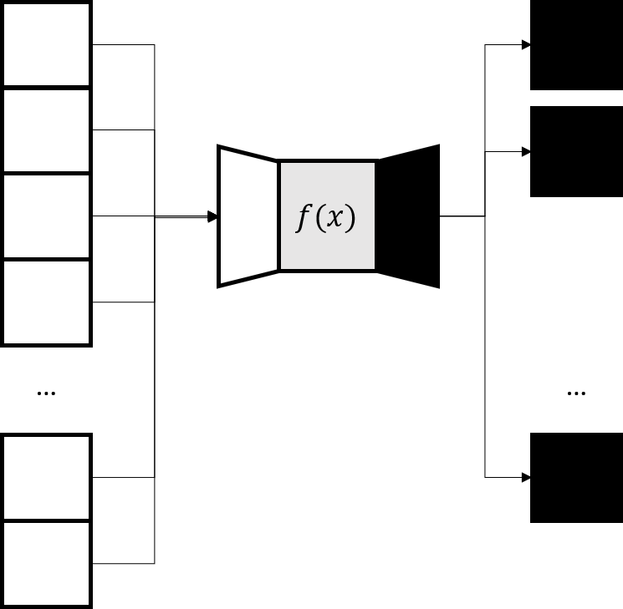
3. Higher order function: map, filter & reduce
map
filter

Slide 14
3. Higher order function: map, filter & reduce
[1, 2, 3, 4].map((x) => {
return x + 1
})
Javascript: event-oriented
incre x = x + 1
array = [1, 2, 3, 4]
map incre array
(or map (incre, array))
Haskell: pure functional

Slide 15
3. Higher order function: map, filter & reduce
[1,2,3,4].filter((x) => {
return (x > 2)
})
Javascript: event-oriented
greaterThan2 x =
| x > 2 = True
| otherwise = False
array = [1, 2, 3, 4]
filter greaterThan2 array
(or filter (greaterThan2, array))
Haskell: pure functional

Slide 16
3. Higher order function: map, filter & reduce
[1,2,3,4].reduce((x, y) => {
return x + y
}, 0)
Javascript: event-oriented
add x y = x + y
array = [1, 2, 3, 4]
foldl add 0 array
(or foldl (add, 0, array))
Haskell: pure functional

Slide 17
3. Higher order function: map, filter & reduce
Note that map, filter and reduce (fold) are the core of functional programming.

Slide 18

4. Homework
a) Define quick sort function
quicksort :: (Ord a) => [a] -> [a]
b) Find $x_{max}≔maximum\left(\left\{x∈ℕ,x<100000,x⋮3829\right\}\right)$

